Slide 1
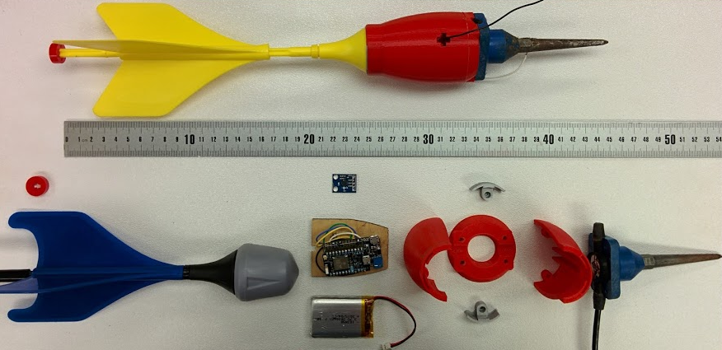
Attachment for deployment mechanism
3-D printed outer case
Accelerometer
Geophone
(Sensors)
Micro-controller
Battery
Lawn Jart

